Slide 1
HIV stigma: Status and future for children and young people?
Barnhivdagen, Fredag 26 September 2026
Desireé Ljungcrantz, PhD, Analyst
Unit for Sexual Health and HIV prevention
Public Health Agency of Sweden

Slide 2
Aim and outline
The aim is to strengthen efforts to eliminate HIV stigma in Sweden by engaging in in-depth dialogues with relevant stakeholders.
Why a session on HIV stigma now?
The Swedish context
What is HIV stigma?
Consequences of HIV stigma
Effective methods for reducing HIV stigma
How do we proceed:
  To normalize HIV, without disregarding the challenges?
  To eliminate HIV stigma?

Slide 3
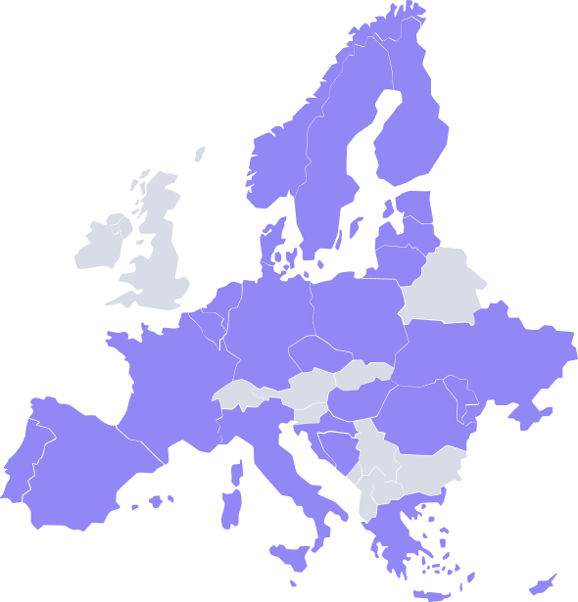

  Focus: HIV, HBV, HCV, HPV. and TB
  2026–2028
  EUR 25 million
  25 European countries
Goal: to reduce infection-driven cancer through surveillance, disease-integrated prevention, early treatment and vaccination, inter alia by reducing barriers created by stigma and discrimination.
WP5.1: Global Partnership to fight Stigma and Discrimination.

Slide 4


5.1: Global Partnership to fight Stigma and Discrimination
Founded in 2018 by UNAIDS’ HIV partner organizations
40 member countries (Oct. 2024)
Support-building is ongoing
Dialogues are ongoing with internal, national, regional and local actors about strengthened work to eliminate HIV stigma
The Global Partnership for Action to Eliminate all Forms of HIV-related Stigma and Discrimination | UNAIDS
Notes:
Internal research group
Civil society organizations receiving grants from the government for to work with HIV and STI prevention
Regional coordinators within the field of SRHR, HIV and STI
The authority network for HIV, STI and SRHR
The conference on HIV in children
The Sexual Health Conference with invited professionals
Intern forskargrupp
Civilsamhällets organisationer som får statsbidrag för att arbeta med hiv och STI
Regionala samordnare inom SRHR, hiv, STI
Myndighetsnätverket för hiv, STI och SRHR
Barnhivkonferensen
Sexhälsokonferensen med inbjudna professioner

Slide 5
The Swedish Context

Slide 6
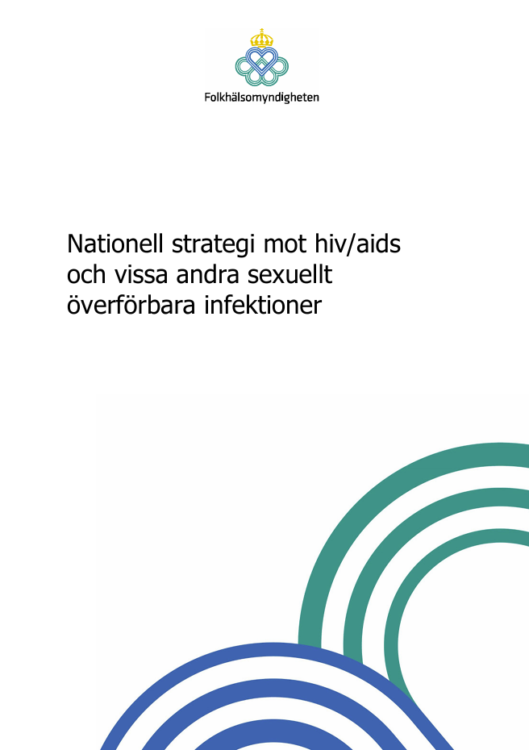
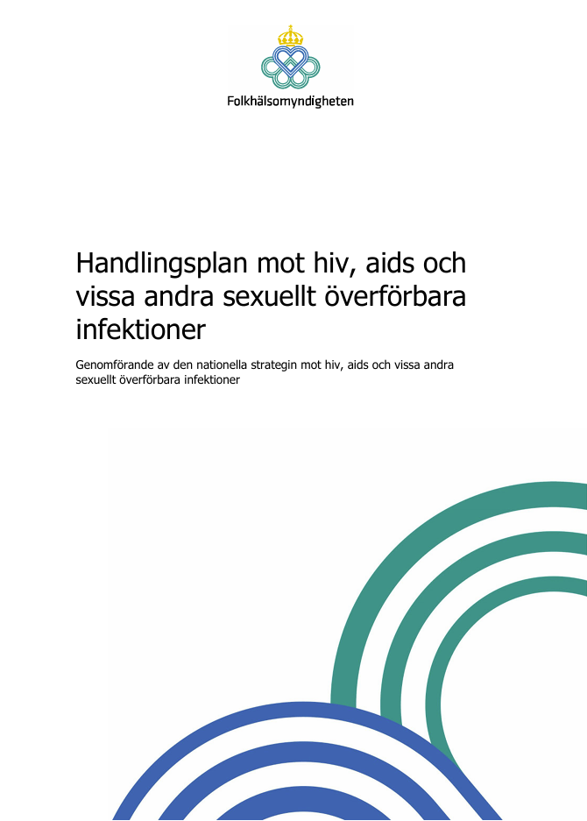
National strategy against HIV/AIDS and certain sexually transmitted infections (2024)
Sub-goal 3: Stigma and discrimination related to HIV infection shall be eliminated.
Sub-goal 4: PLHIV shall, throughout their lives, have equal conditions for good health and good quality of life as the population at large.
→ Activities in the Action plan against HIV, AIDS and certain sexually transmitted infections (2025)

Slide 7
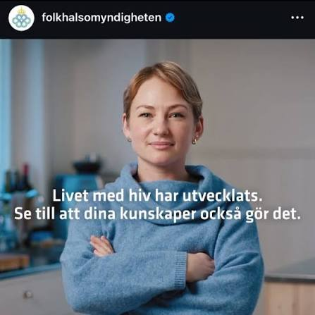


In other words, the goals are:
To normalize HIV as a chronic disease
To eliminate HIV stigma
To improve living conditions and health in the group

Slide 8
HIV in Sweden: The group: 8,588 people at the turn of the year 2024/2025 (InfCareHIV).

Slide 9
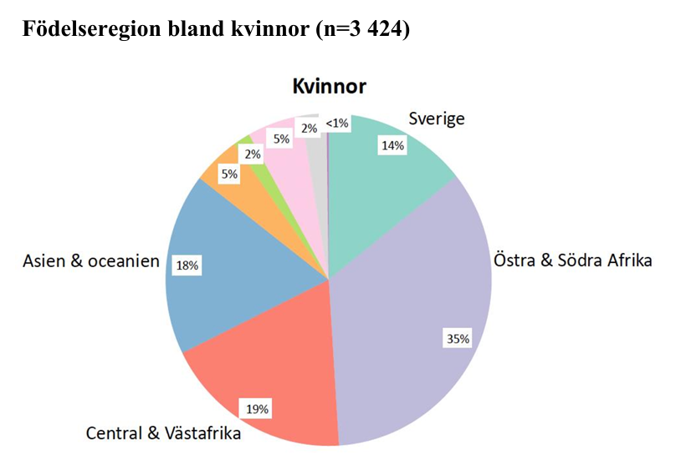
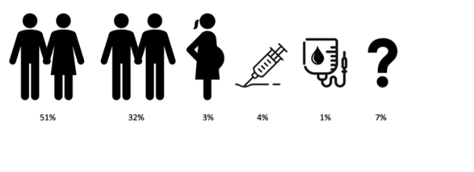
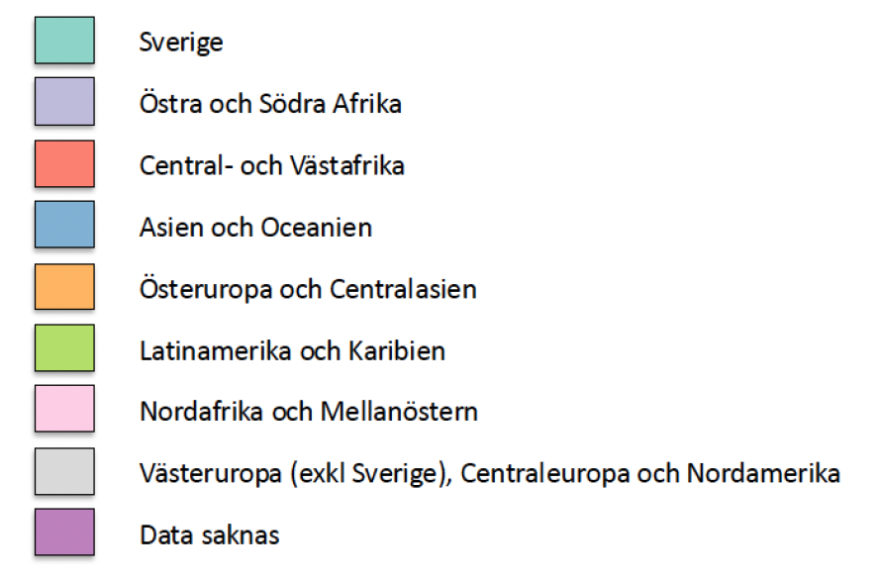
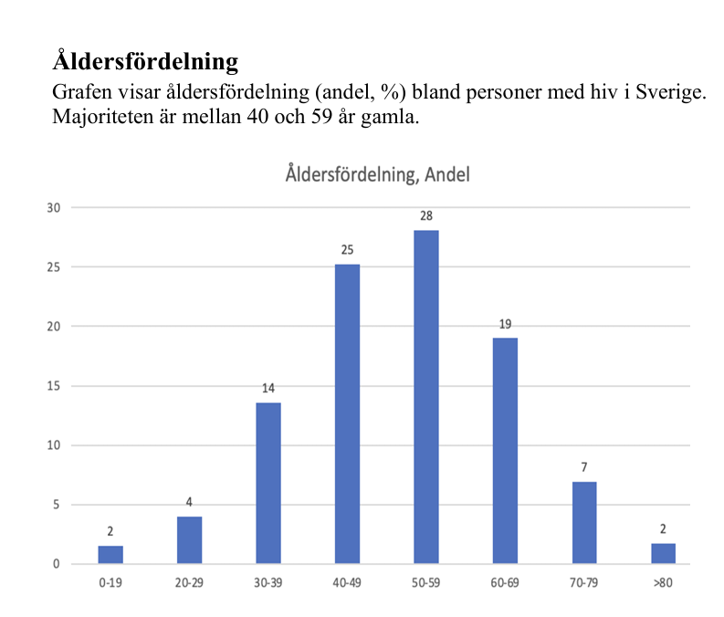
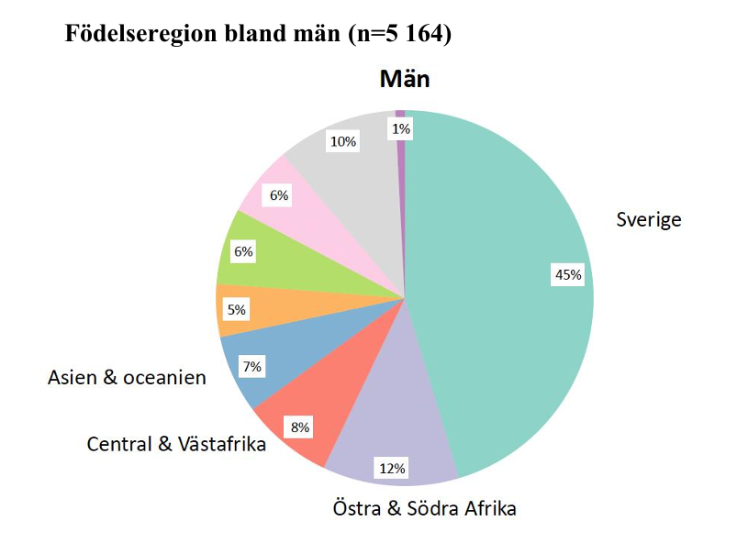
125 children and young people under 20 years of age
77 transgender people, of whom 86% were born in another country
Notes:
InfCAREHIV. Gruppen: 8588 personer (årsskiftet 2024/2025)
Källa: InfCareHIV (årsrapport för 2024)

Slide 10


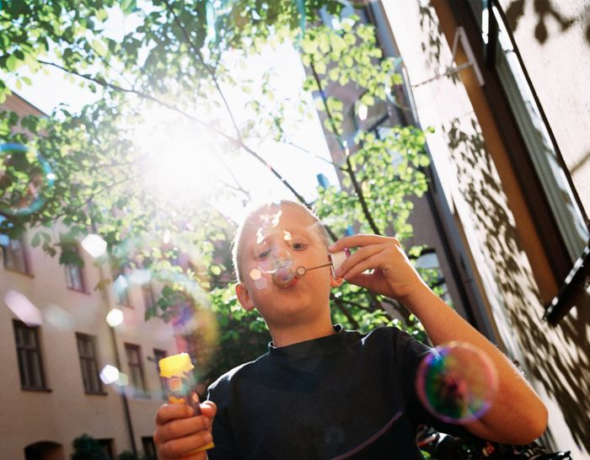










Slide 11
A changing world – with more children and young people with HIV in Sweden ahead?

Slide 12
Knowledge and attitudes

Slide 13
Public knowledge and attitudes
References
Public Health Agency of Sweden (2022).
Dennermalm et al (2025).
Sjöland et al (2026).
4,931 people in the Public Health Agency’s web panel (2022):
39% knew that well-treated HIV is not transmitted through sex
81% were of the opinion that people with well-treated HIV should inform their sexual partners about their HIV
3,100 HIV-negative MSM (2020-2021):
72% did not know that well-treated HIV is not transmitted through sex
Nearly 50% would avoid intimate relationships with someone who has HIV

Slide 14
What is HIV stigma?

Slide 15
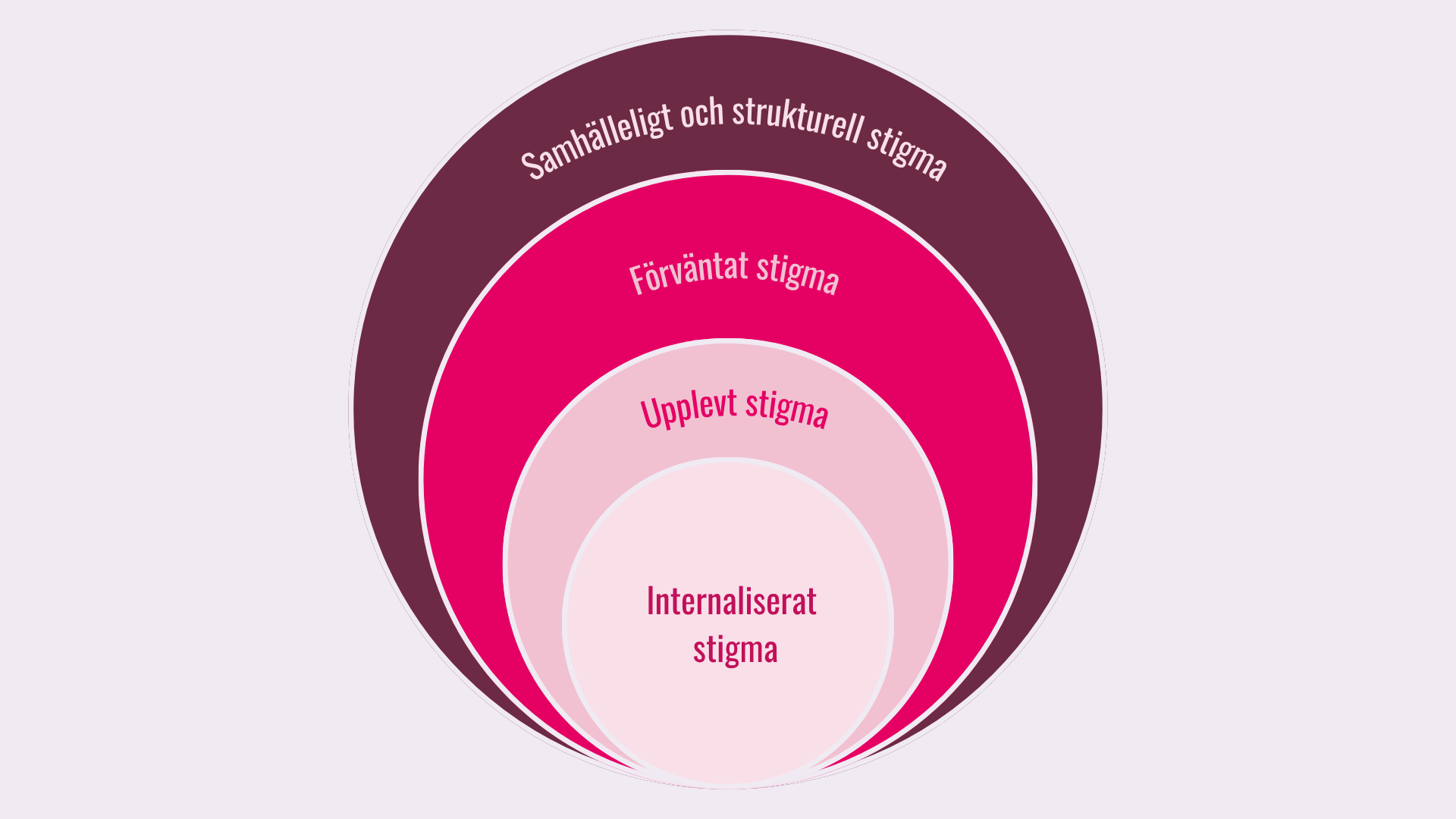
Four dimensions of stigma: living conditions for PLHIV and their consequences for health and quality of life
Prejudice, outdated knowledge, norms, fear, shame etc.
→
Societal and structural stigma
Anticipated stigma
Experienced (perceived) stigma
Internalized stigma
Intersectional stigma
Consequences of HIV stigma for the entire population:
Negative impact on mental and sexual health, worry, involuntary loneliness, feelings of hopelessness, exposure to violence, effects on treatment adherence, etc.
Image by Erica Kanon, Noaks Ark Stockholm.
Notes:
HIV stigma is a socio-structural, interpersonal, individual and psychological phenomenon.
Hivstigma är ett samhällsstrukturellt, mellanmänskligt, individuellt och psykologiskt fenomen

Slide 16
Why HIV stigma in Sweden?
References
Ljungcrantz (2017).
UNAIDS. Global AIDS update 2023: The path that ends AIDS (2023).
ECDC. Stigma: survey of people living with HIV (2023).
Mendez-Lopez A et al (2024).
Dennermalm et al (2025).
In countries with a low HIV-prevalence it is precisely its rarity that drives stigma
Insufficient knowledge about HIV within the healthcare sector tends to increase the prevalence of HIV stigma
HIV is associated with deviating from norms, e.g. migration, sexual minorities and people who inject drugs
The individual is viewed as a failure – having contracted HIV/not having managed to protect him/herself
Notes:
In countries with high HIV-prevalence, more people have experience of living with HIV or know someone who is living with HIV, which can contribute to increased knowledge and the normalization of HIV, potentially reducing HIV-related stigma.
I länder med högre förekomst av hiv har fler
människor erfarenhet av att leva med hiv eller känner någon som lever med hiv, vilket kan bidra
till ökad kunskap och normalisering av hiv som i sin tur kan minskat hivstigma.

Slide 17
HIV stigma among children and young people in Sweden
Notes:
Ca 130 under 19 år 2024/2025

Slide 18
Consequences for children and young people in Sweden
References:
Wiklander et al (2013).
Rydström et al (2013, 2015, 2016).
Public Health Agency of Sweden (2020).
Fear of disclosing HIV
  Intense worry
  Avoidant behaviour to escape negative treatment (and thereby also missing out on possible positive treatment)
  HIV becomes a secret
  HIV creates loneliness: a minority were as open about their HIV status as they wanted to be
Psychosomatic complaints
Negative self-image
High degree of exposure to other kinds of victimization, e.g. violence and other violations
Notes:
Folkhälsomyndigheten (2020), 16-24 år.

Slide 19
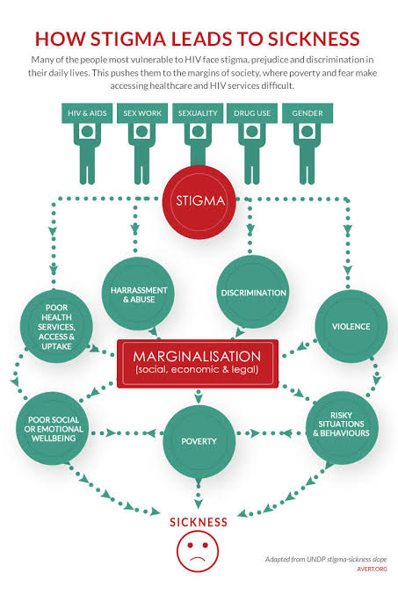

Slide 20
Children’s rights

Slide 21
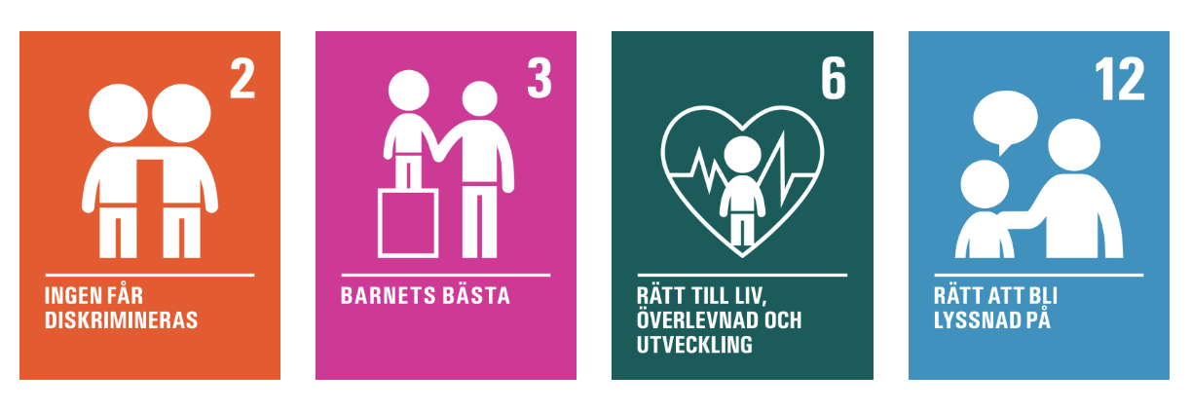
The UN Convention on the Rights of the Child
2. All children are equally valuable and have the same rights. No one may be discriminated against.
3. In all decisions concerning children, the primary consideration shall be what is judged to be in the child’s best interests.
6. Children have the right to life, survival and development.
12. Children have the right to express their views and be heard in all matters concerning the child. The child’s views shall be taken into account, in light of the child's age and maturity.

Slide 22
Which methods work?

Slide 23
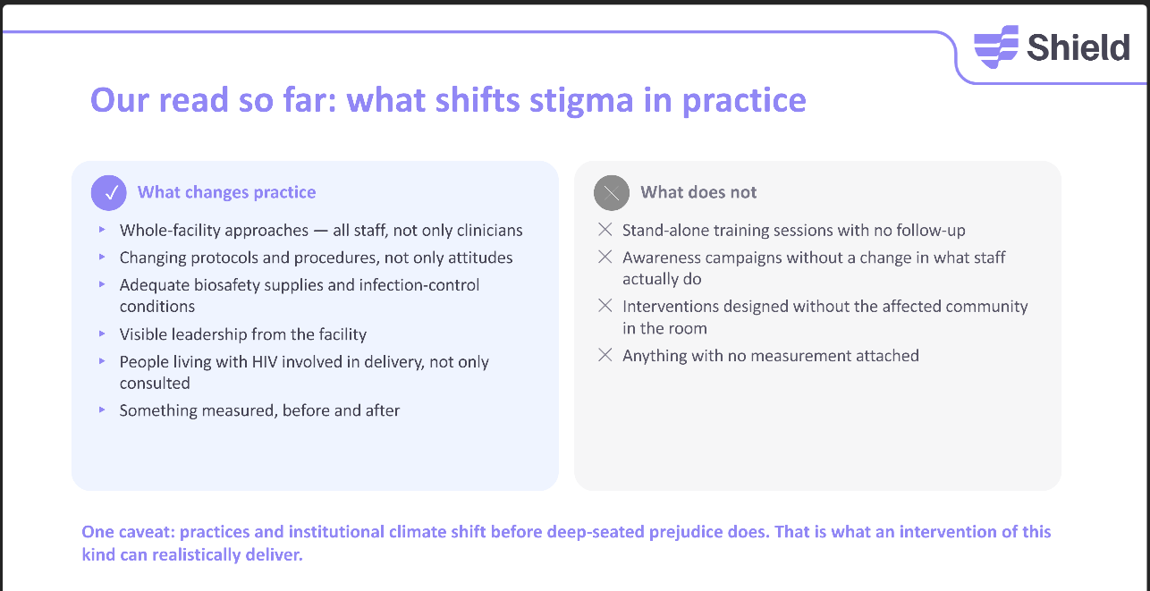
Research summary on effective stigma-reducing methods
Notes:
Institutionella dokument och praktiker

Slide 24
The goals for children and young people
To normalize HIV as a chronic disease for children and young people
To eliminate HIV stigma among children and young people
To improve living conditions and health for children and young people with HIV

Slide 25
What is most important to prioritize?

Slide 26

a) normalize HIV, without disregarding the challenges?
b) eliminate HIV stigma among children and young people in Sweden
Notes:
***behov, hinder, möjligheter*** Needs, obstacles and possibilities

Slide 27



Please get in touch!
Desiree.ljungcrantz@folkhalsomyndigheten.se

Slide 28
Thank you!
Håll dig uppdaterad via vår webbplats,
vårt nyhetsbrev och våra sociala medier.

